Slide 1


CSE Department Scheduler
Project Presentation
Presented By:
Satwik Rath(22JE0875)
Peetala Rishika(22JE0680)
Uddangi Sai Hemanth(22JE1023)
Under the guidance of: Prof.Ayan Das

Slide 2
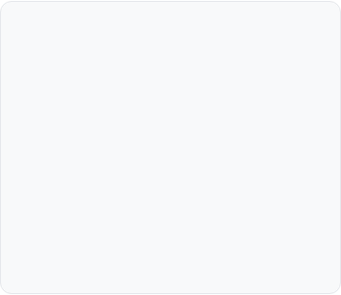





Motivation & Problem Statement
The CSE department manages hundreds of dynamic events, from daily classes to PhD defenses and faculty meetings.
Our current reliance on manual spreadsheets, emails, and logbooks is inefficient and creates a high risk of errors
.
Manual Processes
High Risk of Conflict
No Central Truth
Scheduling relies on manual emails, logbooks, and spreadsheets, which is slow and inefficient.
Leads to frequent "double bookings" of rooms, conflicting faculty meetings, and confusion.
A lack of a single, accessible schedule for all faculty members, HODs, and students.

Slide 3
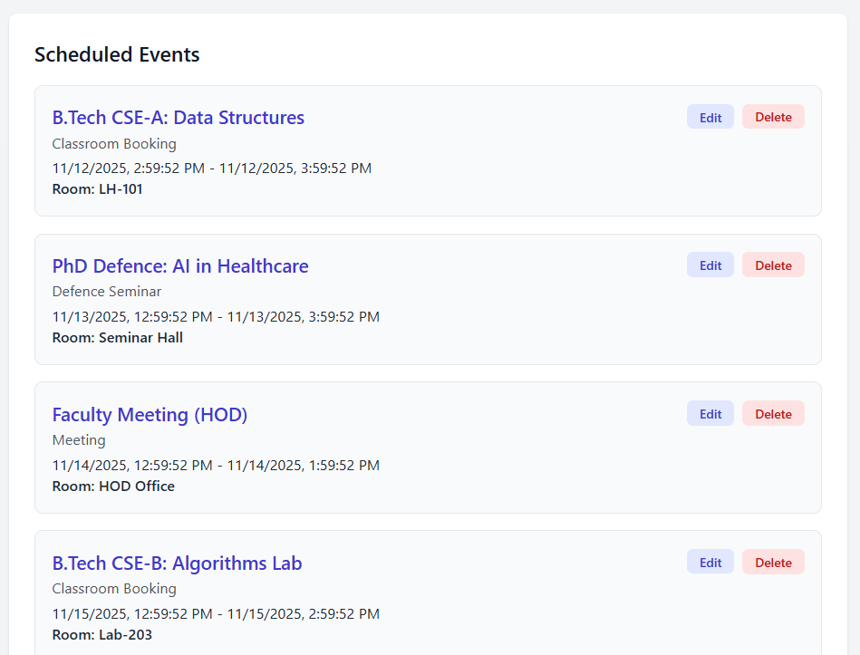
Our Solution & Objectives
A centralized, secure MERN stack web
application to streamline all scheduling.
Centralize: Consolidate all schedules into
one platform.
Prevent: Eliminate 100% of scheduling conflicts
with real-time checks.
Define: Enforce clear permissions for HODs,
Professors, and Students.
Visualize: Offer a clean dashboard and
department-wide calendar.

Slide 4
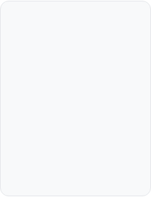
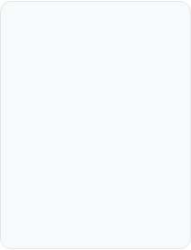
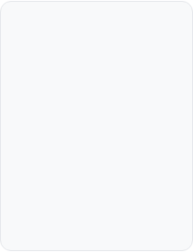





Technology Stack
React
Node.js
MongoDB
Tailwind CSS
JWT
For a dynamic, component-based user interface.
For a fast, scalable, and secure REST API.
For a flexible NoSQL database to store users and events.
For rapid, professional, and responsive UI styling.
For stateless, secure user authentication.

Slide 5








System Architecture: Data Flow (Login)
2. Node.js API
Receives login request
3. MongoDB
Finds user & compares hashed password
1. User (Client)
Enters credentials on React app
POST /api/auth/login
5. React Client
Saves token, redirects to Dashboard
4. Node.js API
Issues a secure JWT (Token)

Slide 6
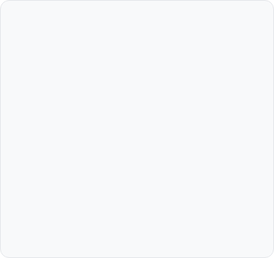
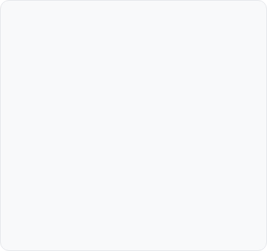
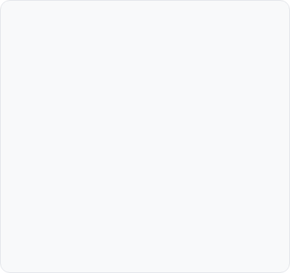



Key Feature: Role-Based Access
HOD / Admin
Professor
Student
Full administrative control. Can Create, Read, Update, and Delete all events. Can invite faculty to meetings.
Can create their own events (e.g., student meetings). Can view public schedules and any private events they are invited to.
Read-only access. Can only view public events like "Classroom Booking" and "Department Event."

Slide 7
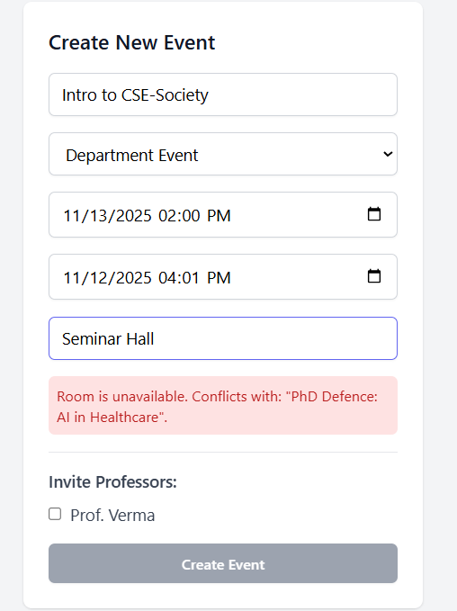

Key Feature: Real-Time Conflict Checking
API (`/check-conflict`) instantly validates room & time.
Frontend `useEffect` hook calls API as HOD types.
Provides instant UI feedback: "✅ Available" or "❌ Unavailable."
"Create Event" button is disabled if a conflict exists.

Slide 8



Core App Functionality
Full CRUD
Invitation System
Calendar View
HODs have full Create, Read, Update, and Delete (CRUD) control over all events.
HODs can fetch a list of all professors and invite specific members to meetings.
A full-page calendar (`react-big-calendar`) provides a visual overview of the department schedule.

Slide 9



Results & Impact
Eliminates Conflicts
Saves Time
Centralized Platform
Successfully prevents 100% of double bookings with real-time server-side validation.
Streamlines the entire scheduling process for all faculty, HODs, and students.
Provides a single, accessible, and reliable source of truth for all department events.

Slide 10
Future Enhancements
Recurring Events
Allow HODs to schedule an event that repeats (e.g., "every Monday for 15 weeks") to create a full timetable.
Notification System
Notify professors (via in-app icon or email) of new meeting invitations and allow them to "Accept" or "Decline."
Advanced Filtering
Add filter and search bars to the dashboard and calendar to find events by room, professor, or type.

Slide 11
Thank You
Questions & Answers

